Slide 1
Preparing the Angular Project Features

Slide 2
Updating the Root Component
The root component is the Angular building block that will manage the contents of the app element in the HTML document.
An application can contain many components, but there is always a root component that takes responsibility for the top-level content presented to the user.

Slide 3
Updating the Root Component (continued)
Now, edit the file called app.component.ts in the SportsStore/src/app folder and replaced the existing code with the statements shown in the following code listing:
import { Component } from '@angular/core';
@Component({
selector: 'app',
template: `<div class="bg-success p-2 text-center text-white">
This is SportsStore
</div>`
})
export class AppComponent {}

Slide 4
Updating the Root Component (continued)
The @Component decorator tells Angular that the AppComponent class is a component, and its properties configure how the component is applied.
The properties shown in the code listing above are the most basic and most frequently used.
The selector property tells Angular how to apply the component in the HTML document, and the template property defines the HTML content the component will display.
Components can define inline templates, like this one, or they use external HTML files, which can make managing complex content easier.
There is no code in the AppComponent class because the root component in an Angular project exists just to manage the content shown to the user.
Initially, we’ll manage the content displayed by the root component manually, but in later lessons, we’ll use a feature called URL routing to adapt the content automatically based on user actions.

Slide 5
Updating the Root Module
There are two types of Angular modules: feature modules and the root module.
Feature modules are used to group related application functionality to make the application easier to manage.
We will create feature modules for each major functional area of the application, including the data model, the store interface presented to users, and the administration interface.

Slide 6
Updating the Root Module (continued)
The root module is used to describe the application to Angular.
The description includes which feature modules are required to run the application, which custom features should be loaded, and the name of the root component.
The conventional name of the root component file is app.module.ts, which is created in the SportsStore/src/app folder.

Slide 7
Updating the Root Module (continued)
No changes are required to this file for the moment; the following code listing shows its initial content:
import { BrowserModule } from '@angular/platform-browser';
import { NgModule } from '@angular/core';
import { AppComponent } from './app.component';
@NgModule({
declarations: [
AppComponent
],
imports: [
BrowserModule
],
providers: [],
bootstrap: [AppComponent]
})
export class AppModule { }

Slide 8
Updating the Root Module (continued)
Similar to the root component, there is no code in the root module’s class.
That’s because the root module only really exists to provide information through the @NgModule decorator.
The imports property tells Angular that it should load the BrowserModule feature module, which contains the core Angular features required for a web application.
The declarations property tells Angular that it should load the root component, the providers property tells Angular about the shared objects used by the application, and the bootstrap property tells Angular that the root component is the AppComponent class.
We’ll add information to this decorator’s properties as we add features to the SportsStore application, but this basic configuration is enough to start the application.

Slide 9
Inspecting the Bootstrap File
The next piece of plumbing is the bootstrap file, which starts the application.
The bootstrap file uses the Angular browser platform to load the root module and start the application.

Slide 10
Inspecting the Bootstrap File (continued)
No changes are required for the contents of the main.ts file, which is in the SportsStore/src folder, as shown in the following code listing:
import { enableProdMode } from '@angular/core';
import { platformBrowserDynamic } from '@angular/platform-browser-dynamic';
import { AppModule } from './app/app.module';
import { environment } from './environments/environment';
if (environment.production) {
enableProdMode();
}
platformBrowserDynamic().bootstrapModule(AppModule)
.catch(err => console.error(err));

Slide 11
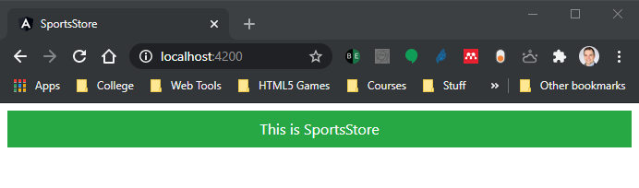
Inspecting the Bootstrap File (continued)
The development tools detect the changes to the project’s file, compile the code files, and automatically reload the browser, producing the content shown:

